Slide 1
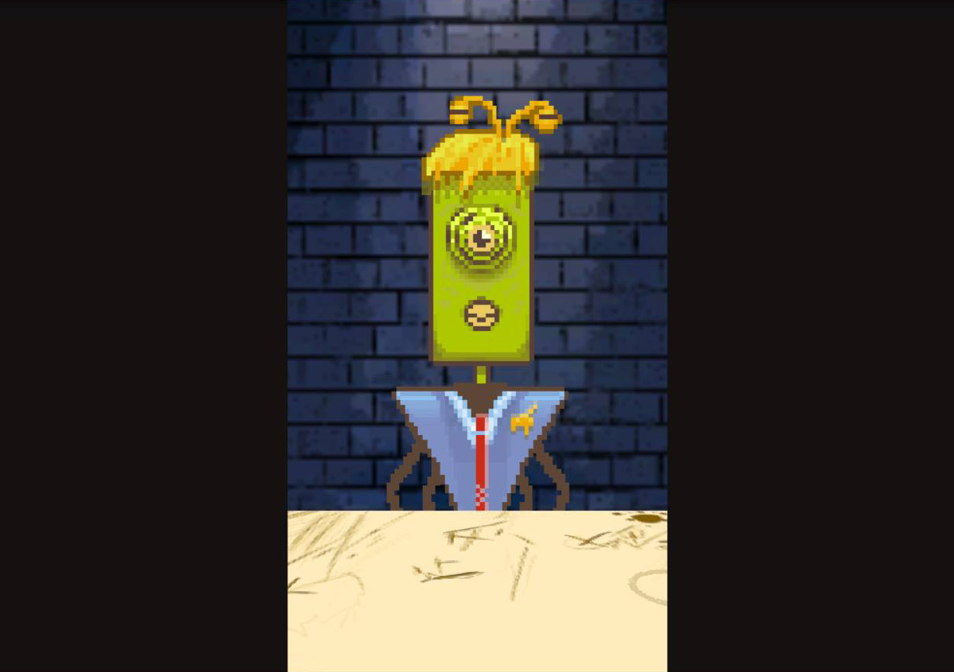
Alien Attorney
Andrew Benson
Daniel Fernandes
Orien Longo

Slide 2
Brainstorming Brainstorming

Slide 3
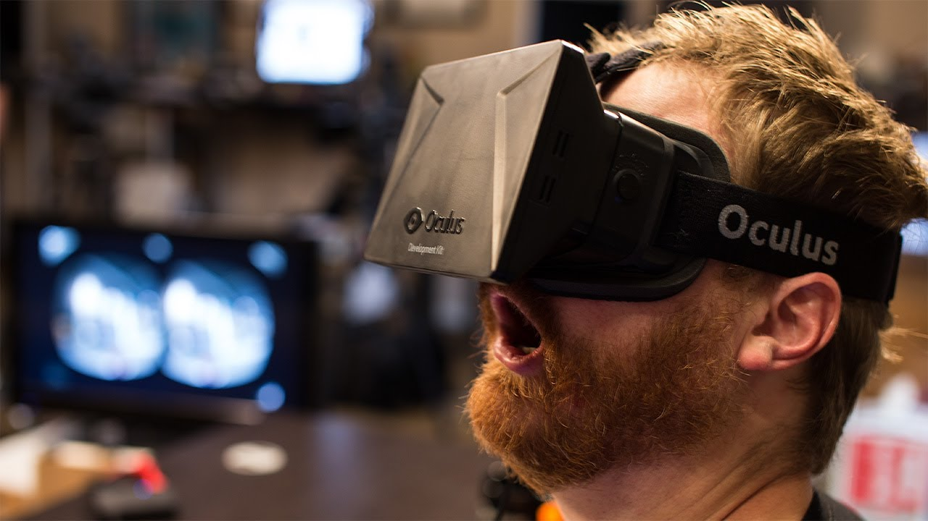
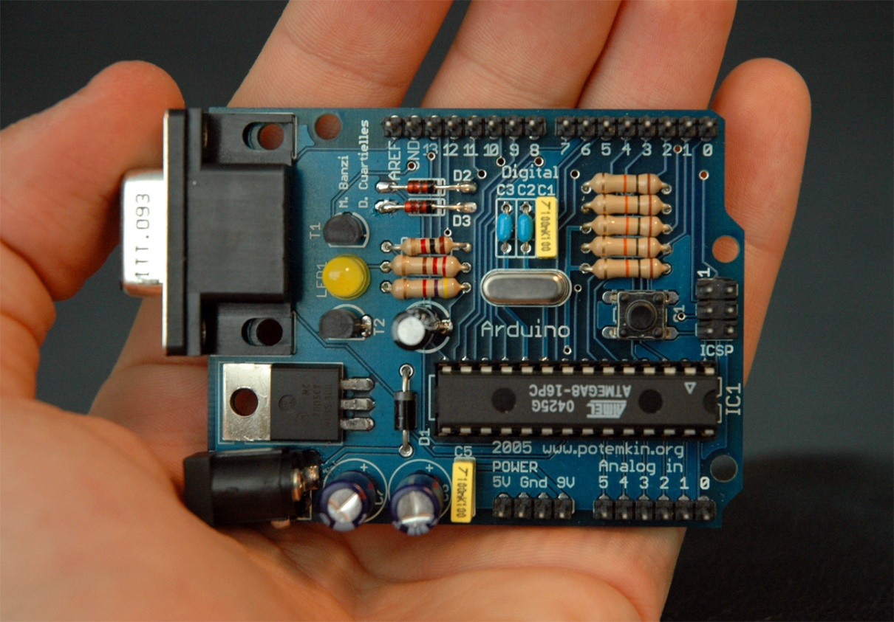

Slide 4
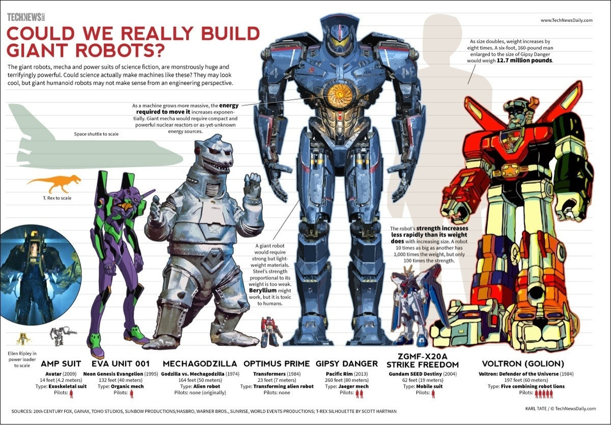
Giant Robot Giant Robot

Slide 5
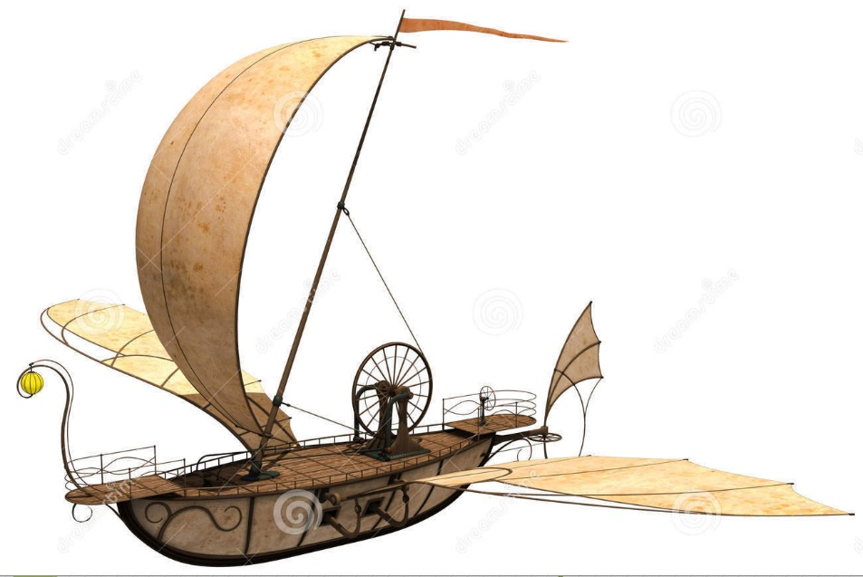
Flying Ship Flying Ship

Slide 6
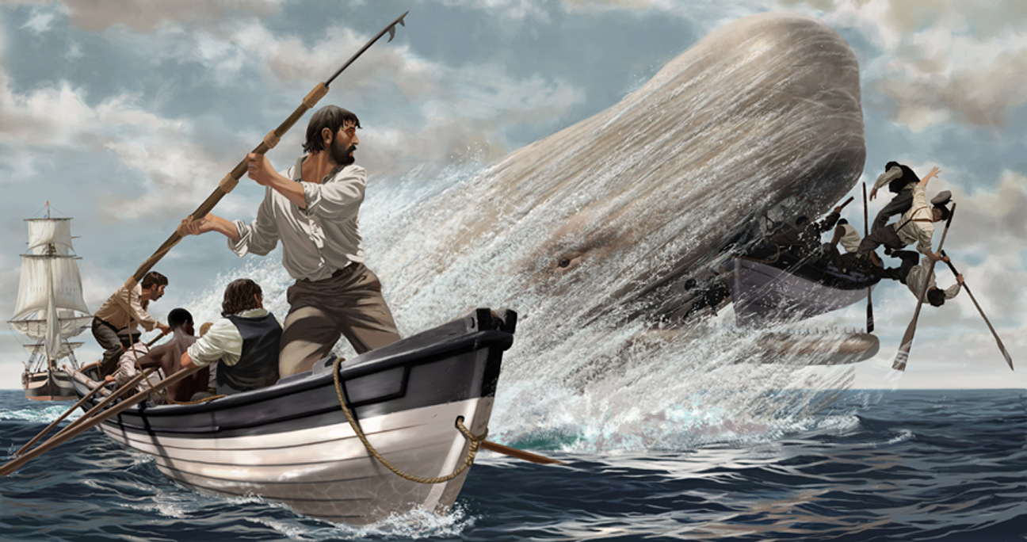
Not-Flying Ship Not-Flying Ship

Slide 7
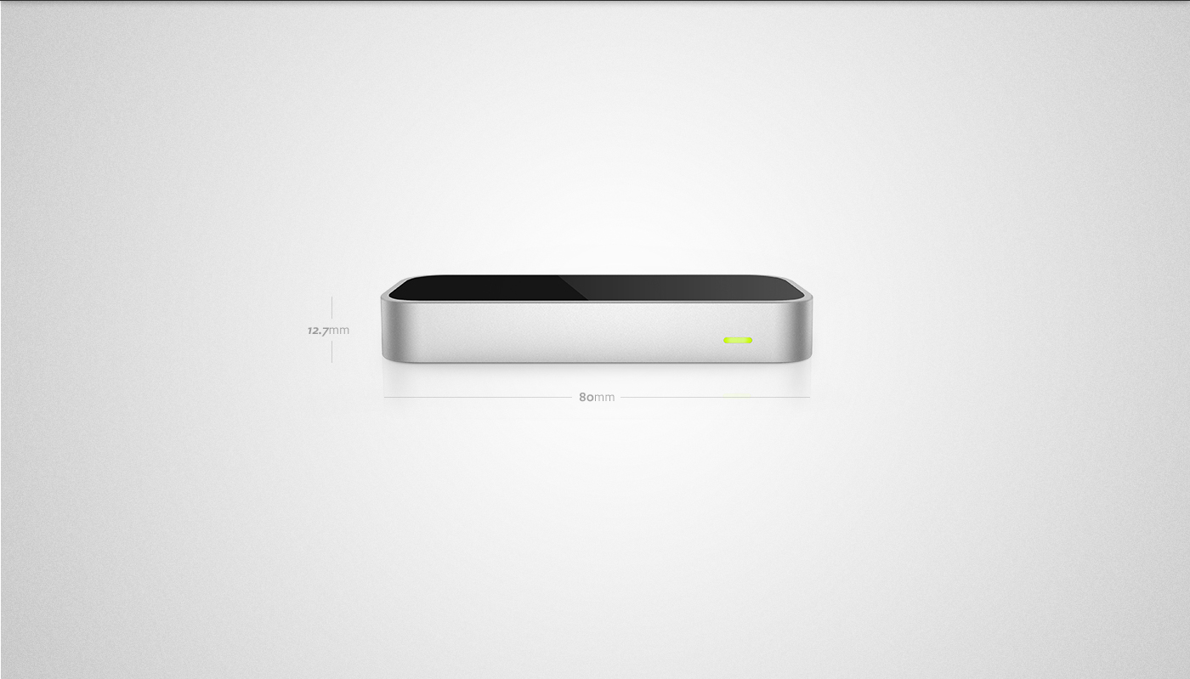

Slide 8

Leap Motion Leap Motion

Slide 9
Leap Ideas Leap Ideas
God Simulator
Create landscapes
Create galaxies
‘Moby Dick’ idea
Expanded to include Leap controls for harpoon
Alien Shooter
Shoot lasers from hands at enemies
Communication Simulator
Sign Language
Communicating without a common language

Slide 10
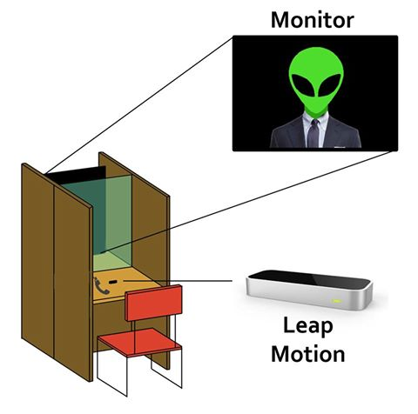
Alien Attorney Alien Attorney

Slide 11
Learning Leap Learning Leap
Gesture Controls
Collider Issues
Pointing
Raycasting
Virtual button to ‘confirm’ selection

Slide 12
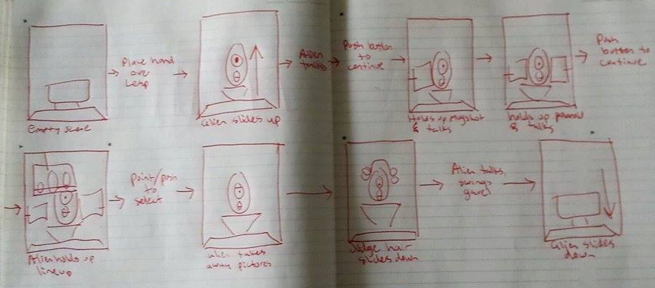
The Story The Story

Slide 13
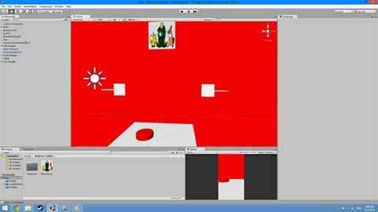
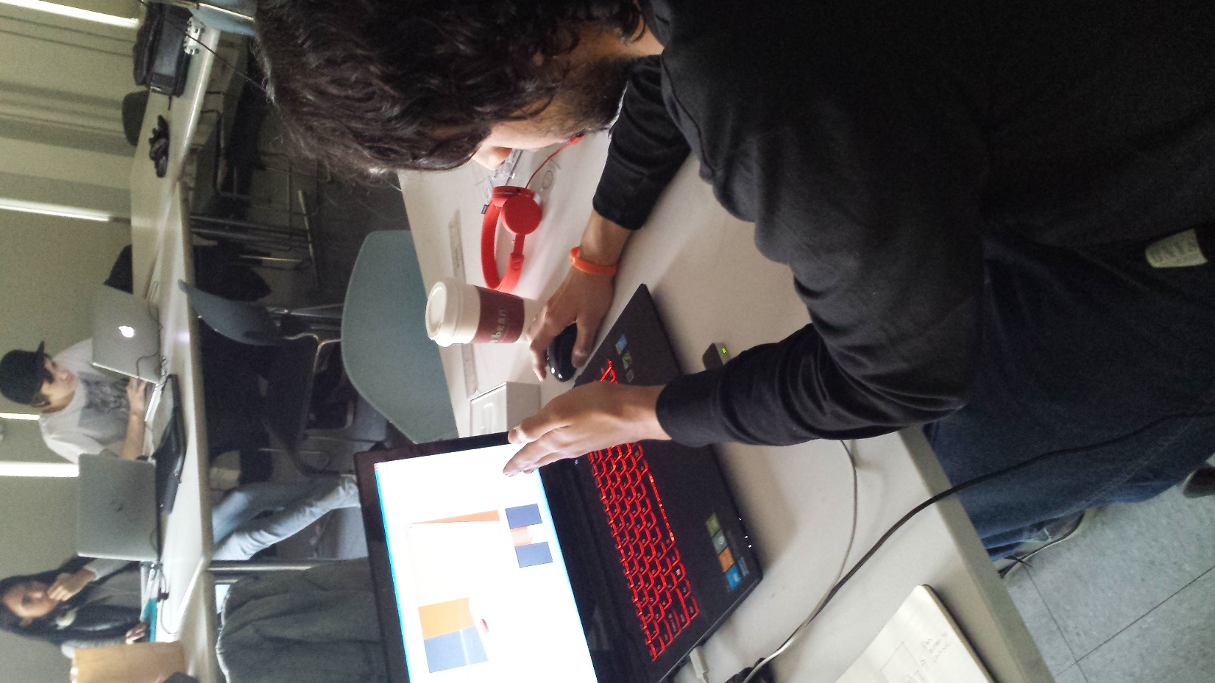
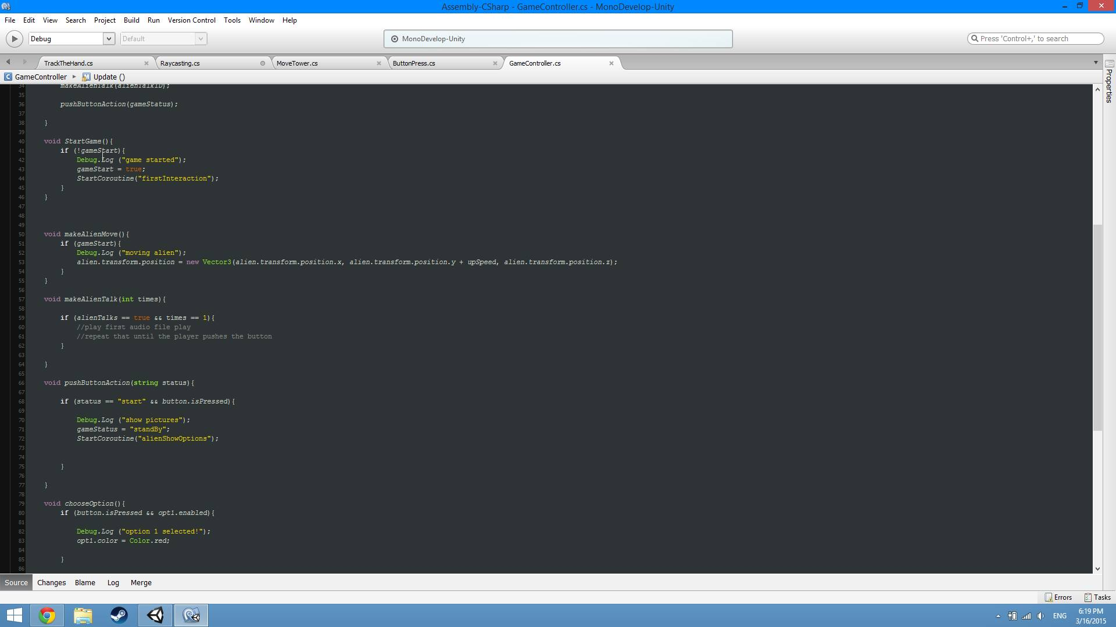
The Game The Game

Slide 14
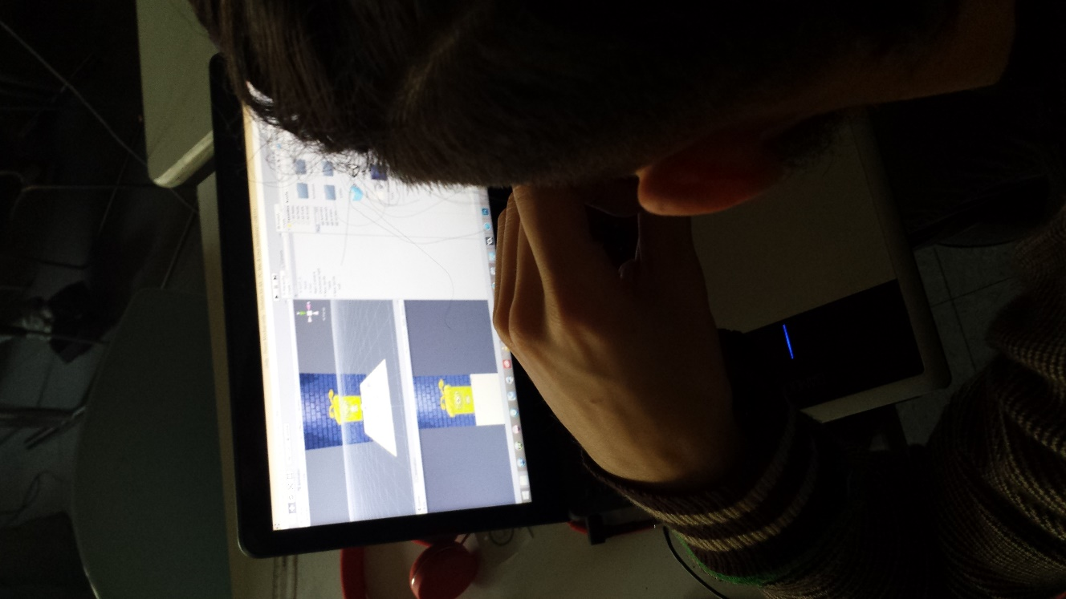
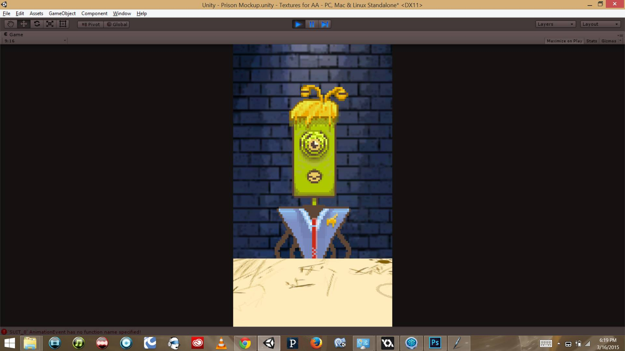
The Visuals The Visuals

Slide 15
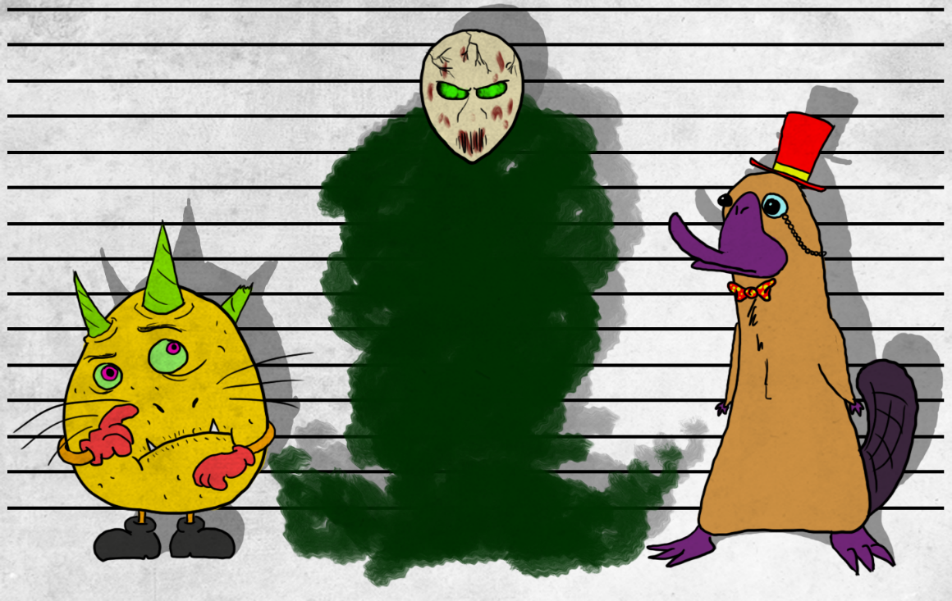
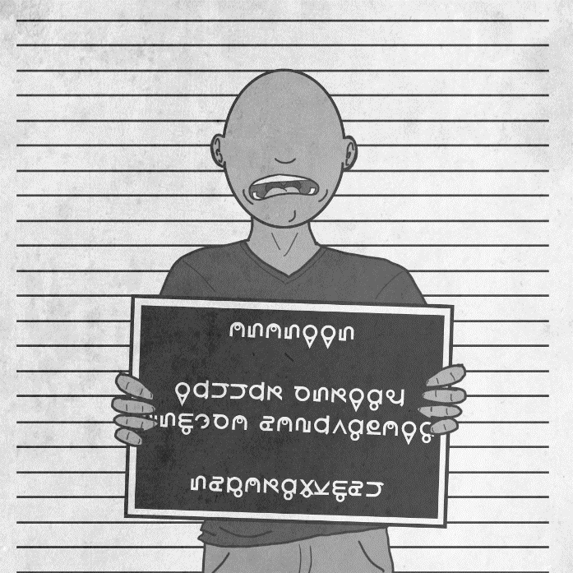
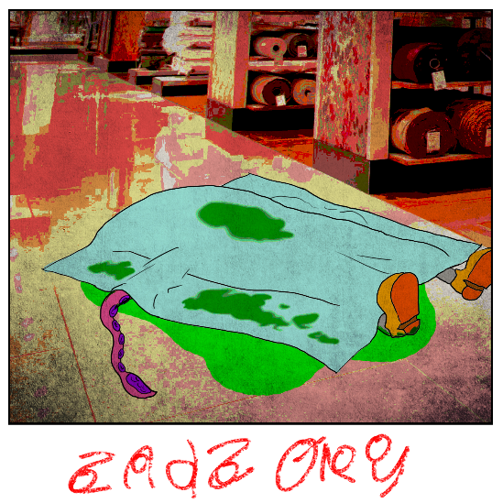
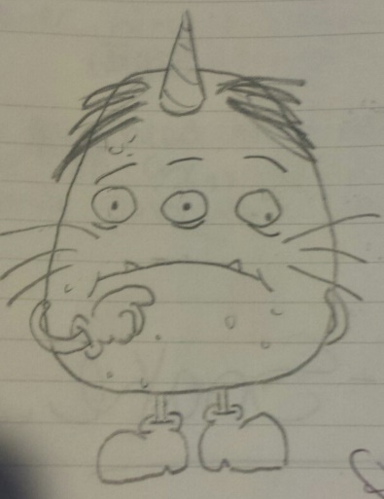
The Visuals The Visuals

Slide 16
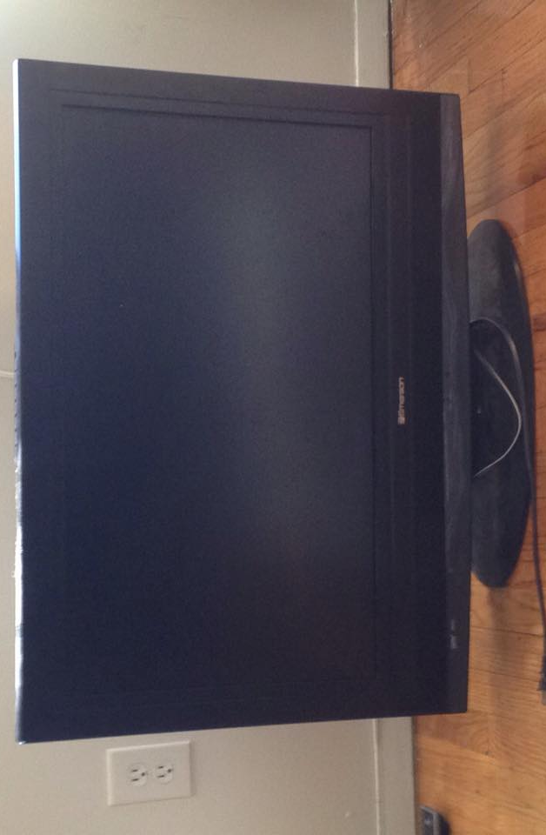
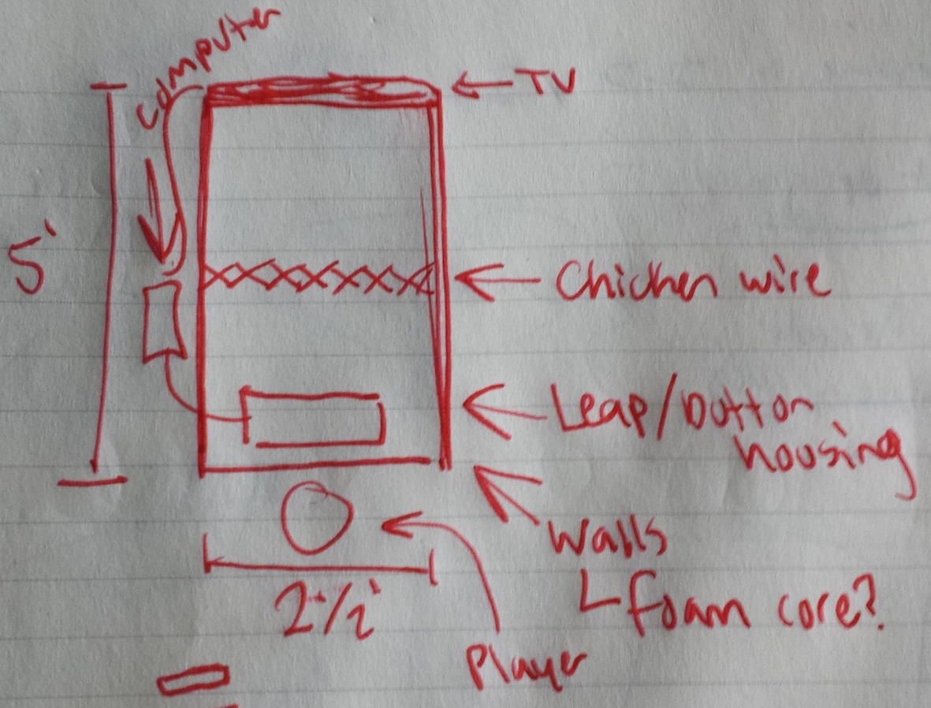
The Table The Table

Slide 17
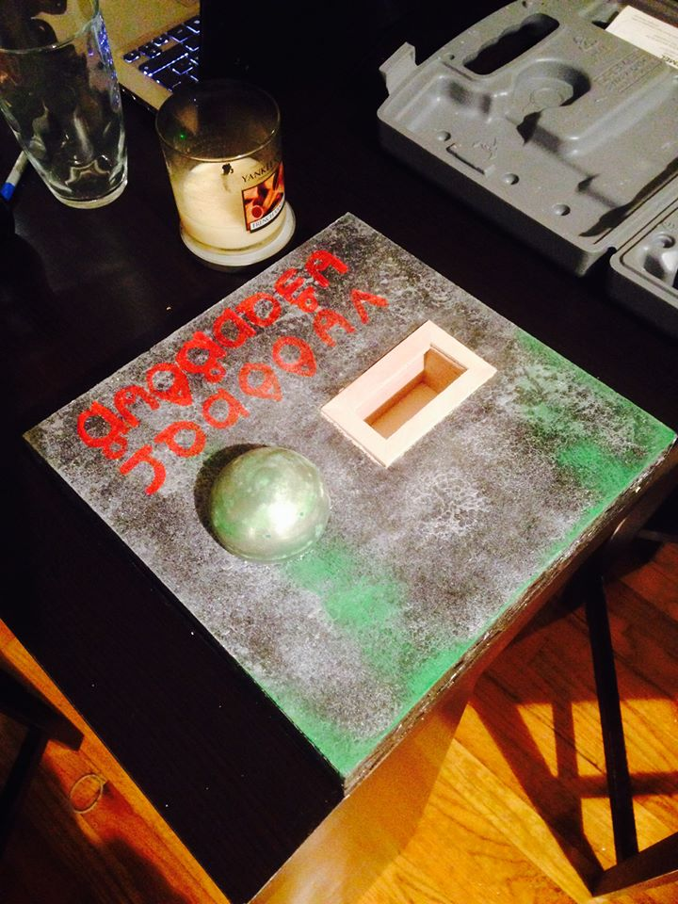
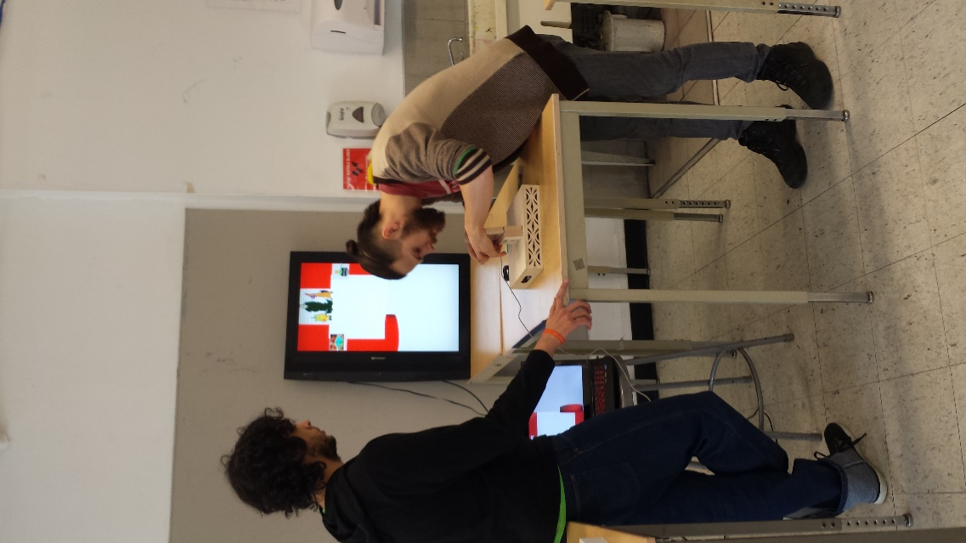
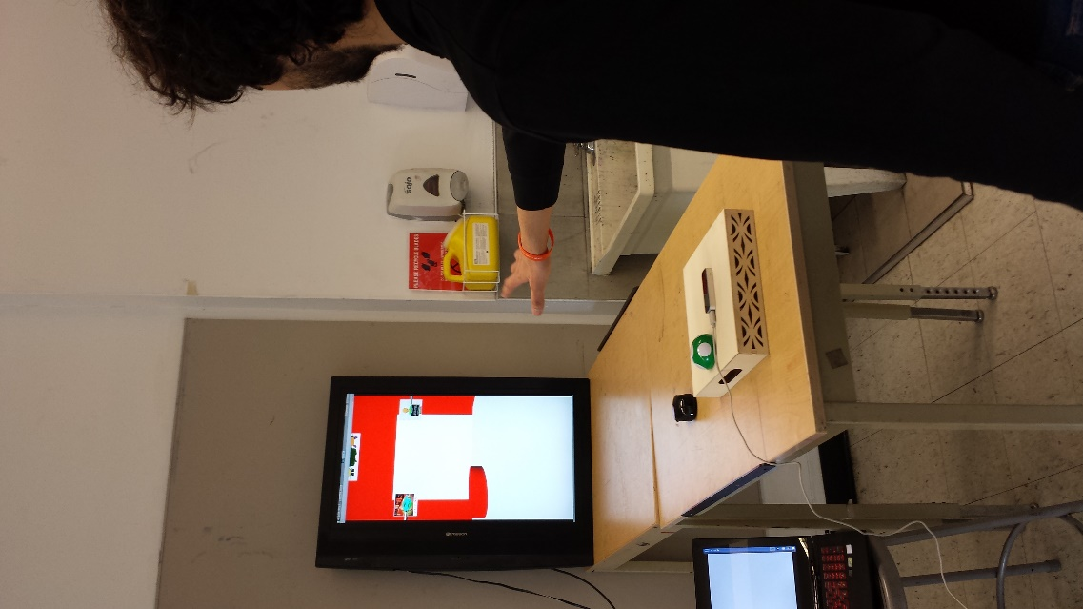
The Table The Table

